Slide 1
The Pos-Chair
An innovative new posture sensing and correcting device
Group A: Jon Ali, Aurielle Barnett, Gabriel Botero, Riley Forster, Jennifer Yang

Slide 2
Design Opportunity
Good posture prevents strain/stress on muscles and bones associated with pain
Current posture aid fail to fully holistically address posture correction
Neglects posture correction in multiple areas of body
Failure to provide user feedback to fix poor posture
Notes:
Good posture is integral in maintaining a healthy lifestyle. Proper form prevents adding stress and strain to the muscles, bones, and ligaments associated with muscular pain (especially back and neck pain)

Slide 3
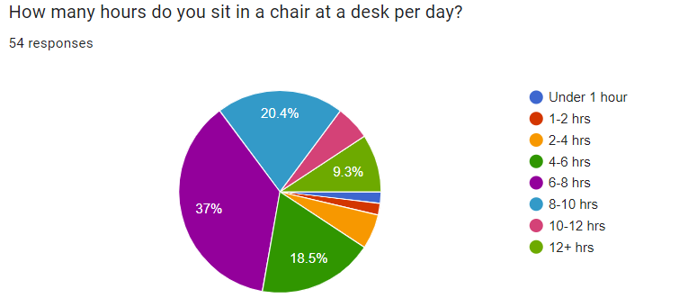
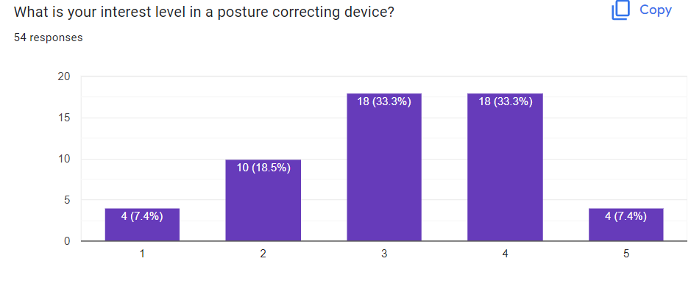
Targeted Stakeholders
People who sit at a desk for several hours every day
High need and interest level demonstrated
Survey participants self-evaluated posture as below average
Medical Professionals
Chiropractors
Physical Therapists

Slide 4
Design Requirements
Accurate posture sensing with maximum 20% error
Setup time under 10 minutes
Able to accommodate weight and height of:
Minimum: 5th percentile female
Maximum: 95th percentile male
User rating of 8-10 out of 10 for the following:
Clear feedback to the user
Increased awareness of posture
Nonintrusive and comfortable
Ease of setup
Notes:
Our design should be able to accurately sense posture with a maximum of 20% error.
The setup should be quick, under 10 minutes.
It should be able to accommodate various heights and weights, ranging from the 5th percentile female to 95th percentile male.
Additionally, we expect high user ratings for the clarity of feedback, increased posture awareness, device comfort, and ease of setup.

Slide 5
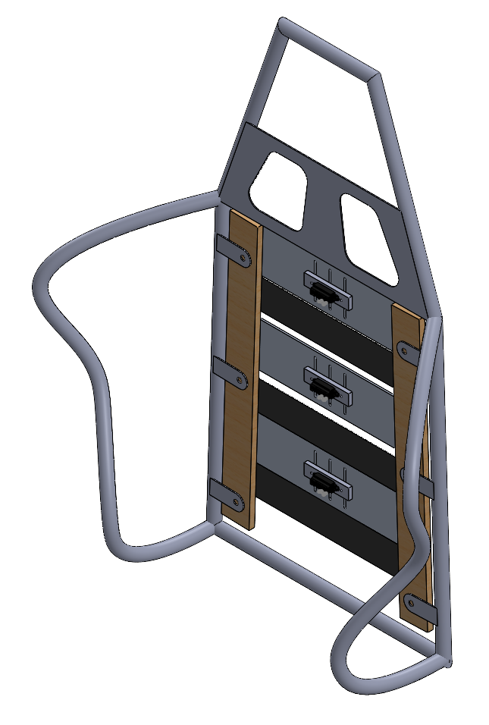
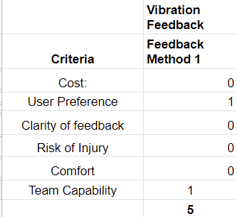
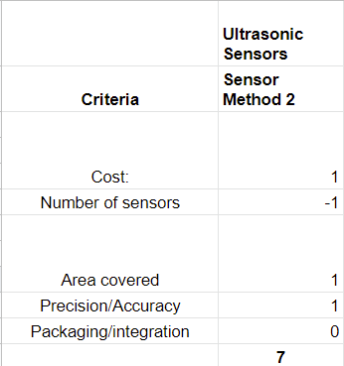
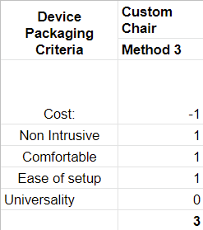
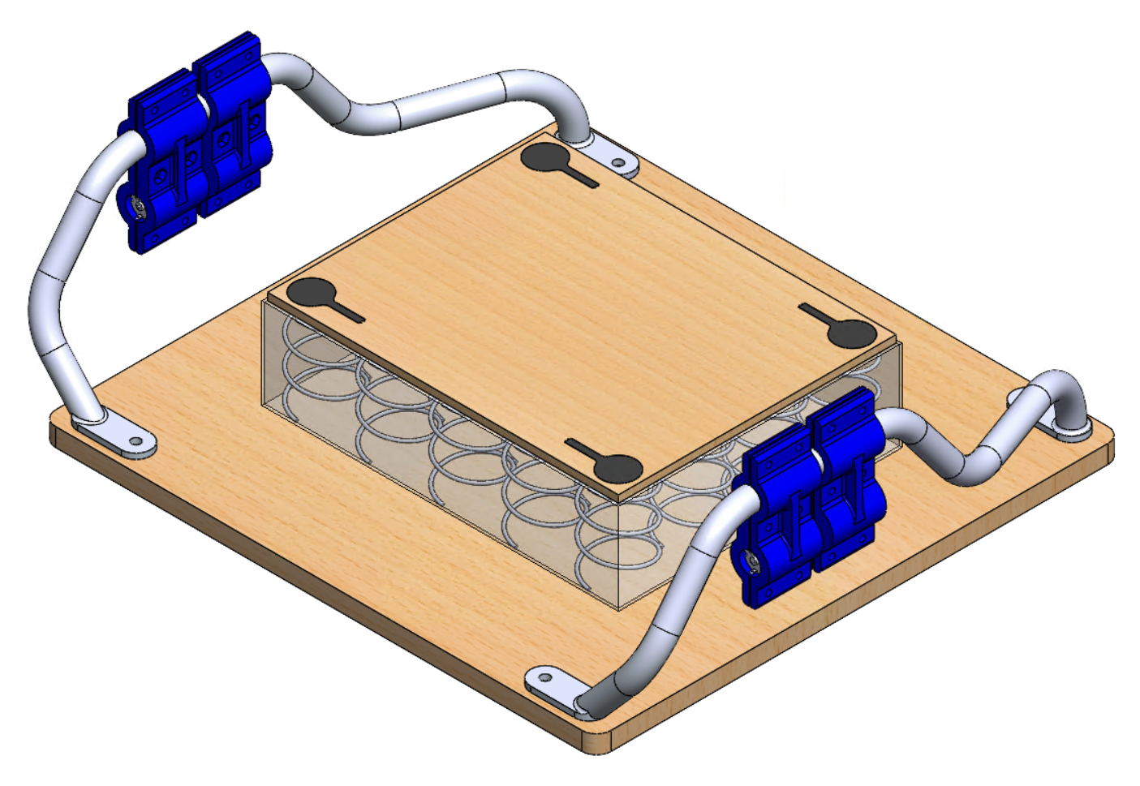
Chosen Design
Pugh Charts for 3 subsystems - Feedback, Sensing, and Device Packaging
Additional sensing system added in the seat of the chair
Notes:
3 subsystems
Possible methods for each subsystem
CAD of chosen design - custom chair with IR sensors in the back and weight sensors in the seat
Added sensing system based on conversations with physical therapists about the most accurate way to determine good posture

Slide 6
Prototype Activities
Prototyping goals
Prototypes generated
Tests performed on prototypes (videos, images)
How well or poorly do prototypes meet design requirements
Summarize prototype discoveries
Jon, Aurielle, Jennifer each 1-2 slides

Slide 7
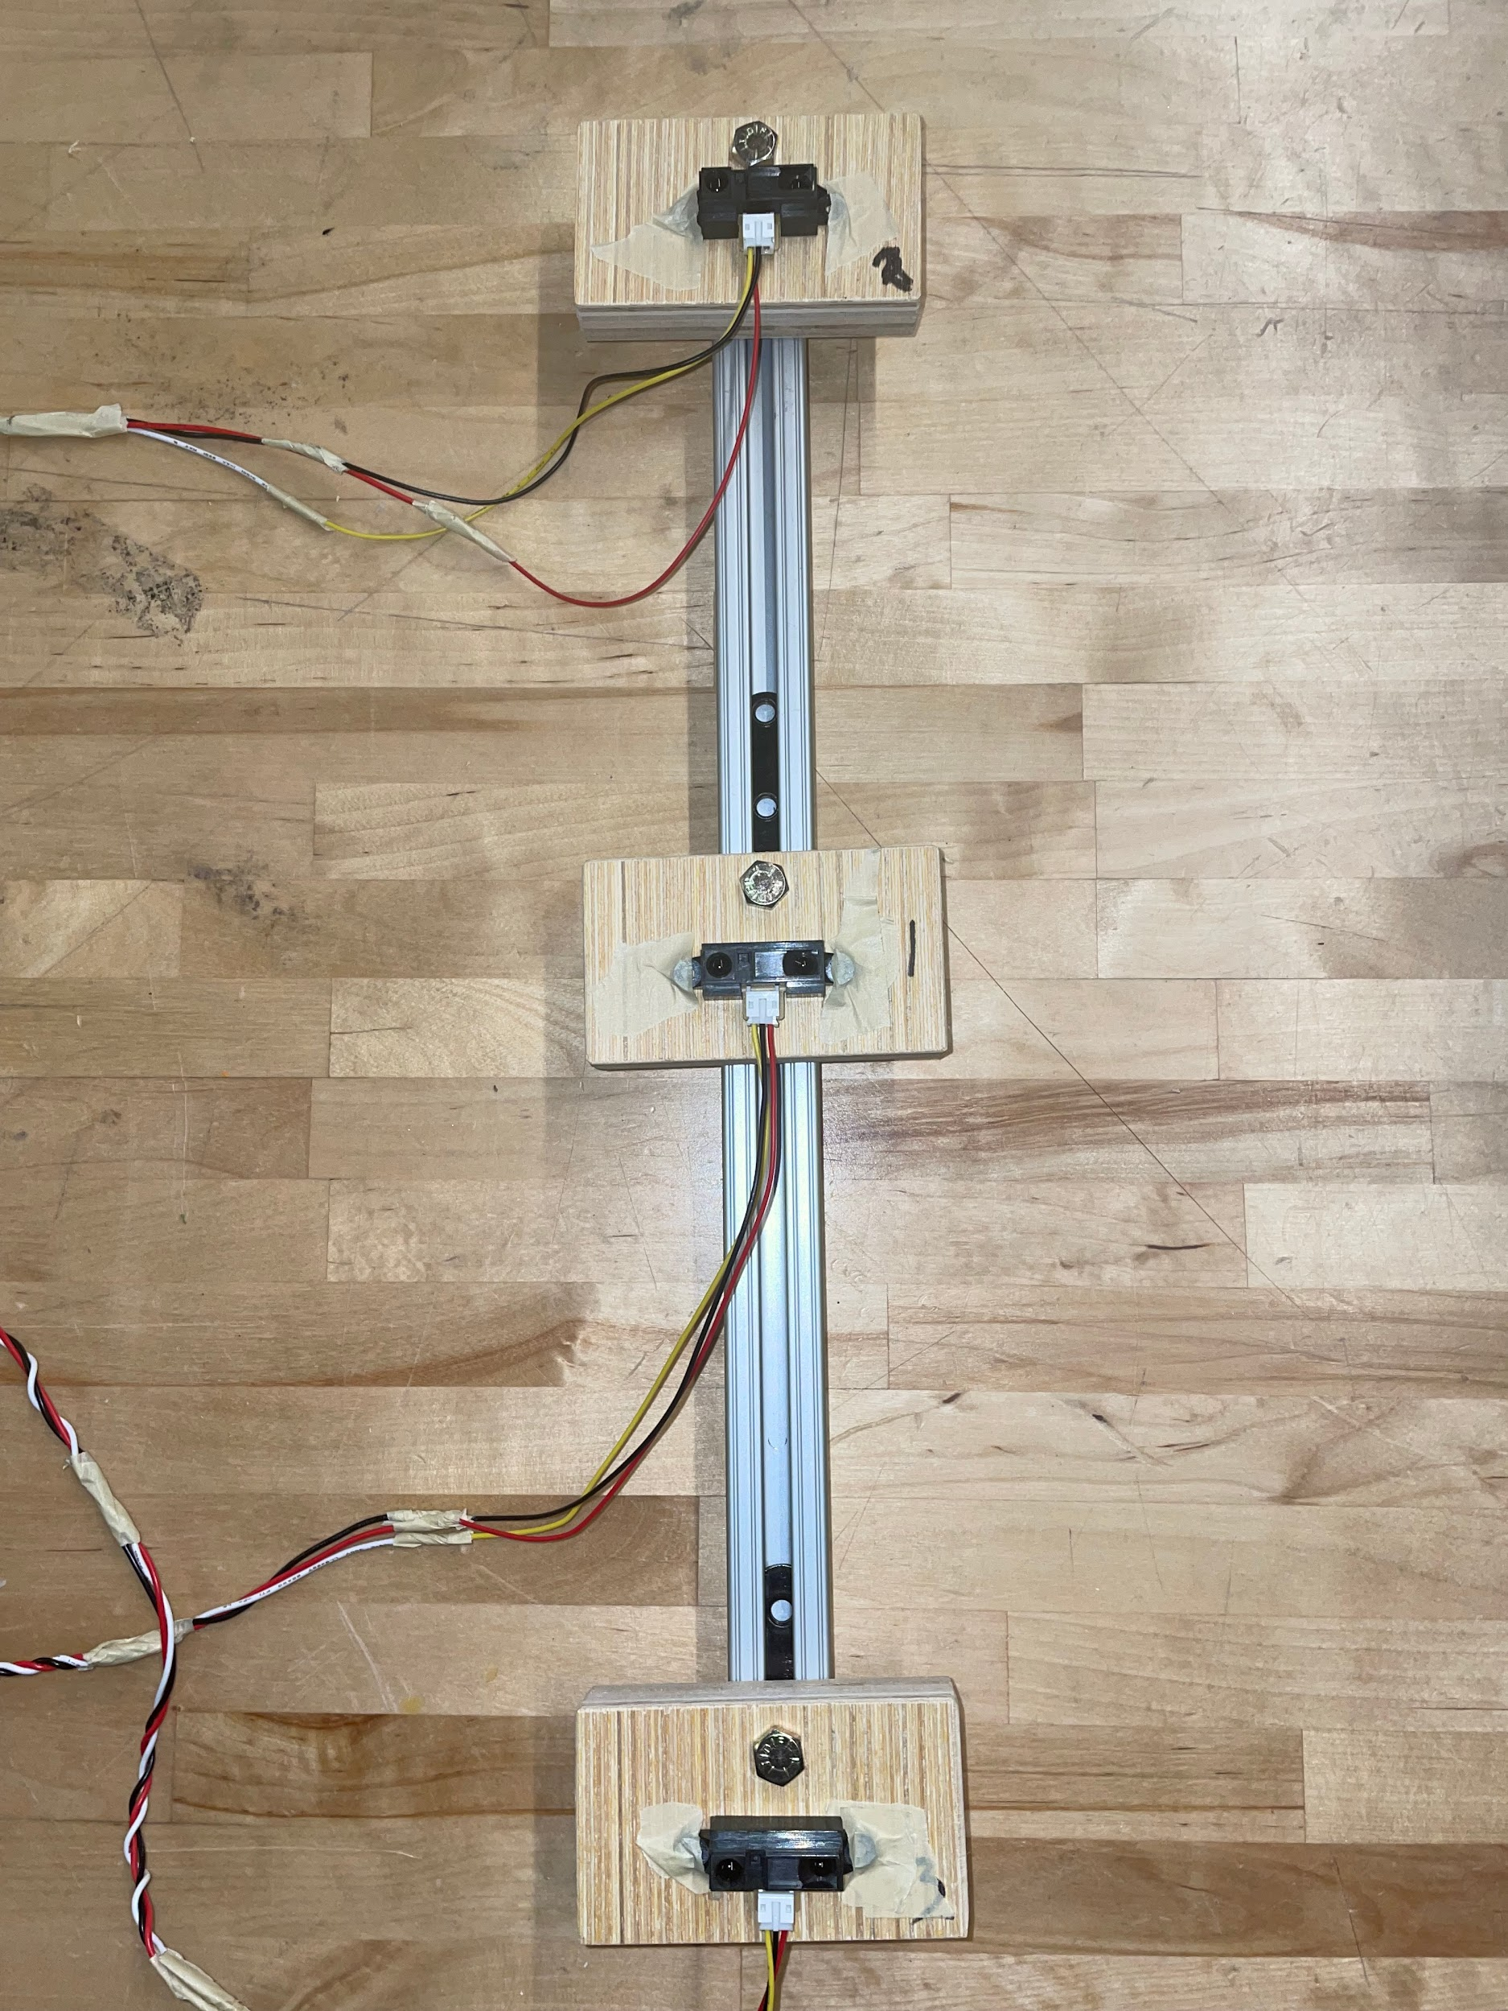
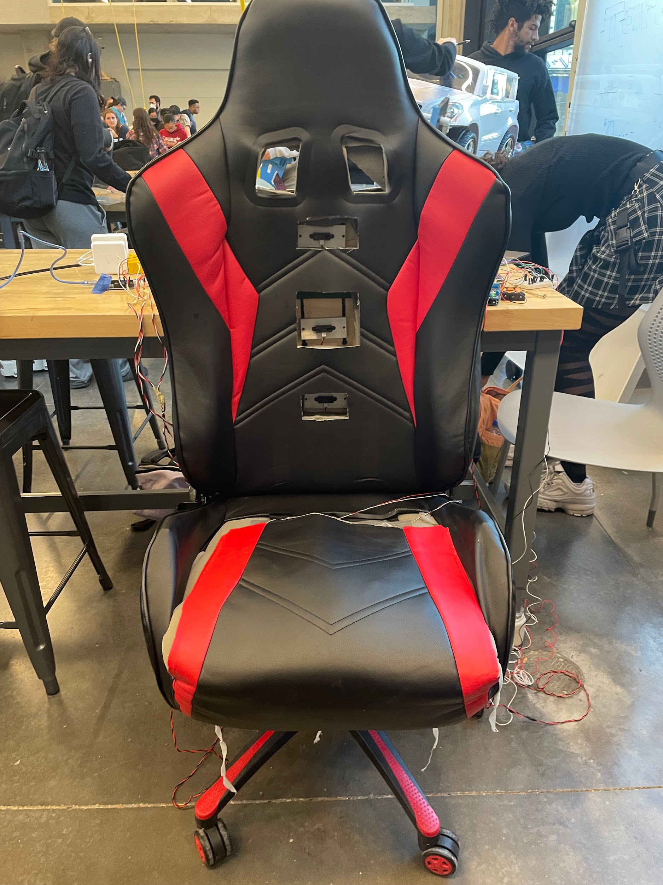
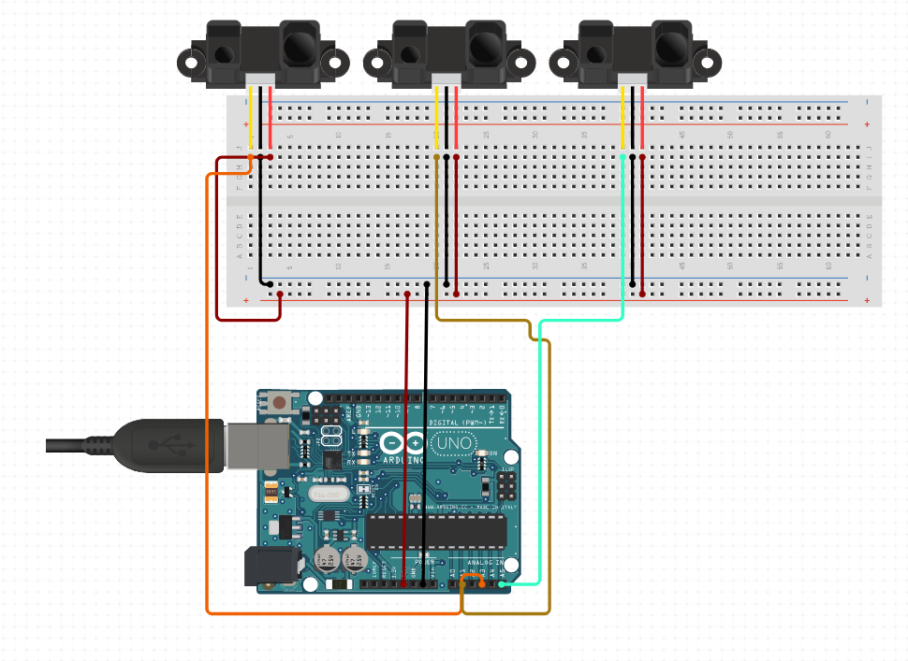
Infrared Prototype Recap
Prototype 1
Prototype 2
Pt-by-Pt Time Series Data
Noisy Data reduced via average 5 readings/s
Extraneous readings treated as nulls
Notes:
Address accuracy/precision of infrared readings

Slide 8
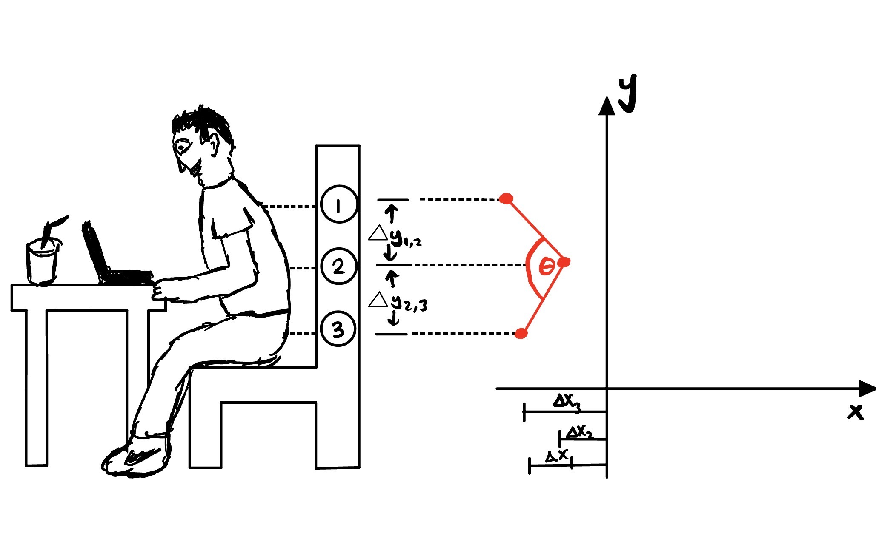
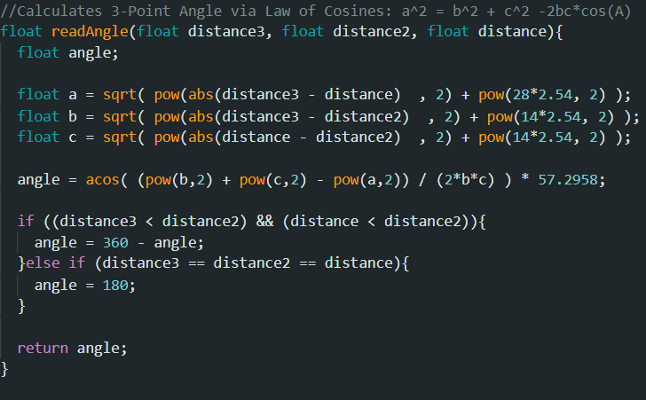
Angle of Crouch Approximation
3-Point Cartesian Analysis
Arduino code used Law of Cosines: a^2 = b^2 + c^2 -2bc*cos(𝛳)
Notes:
Note: 14 cm distances aren’t fixed and user defines as dX1 & dX2

Slide 9
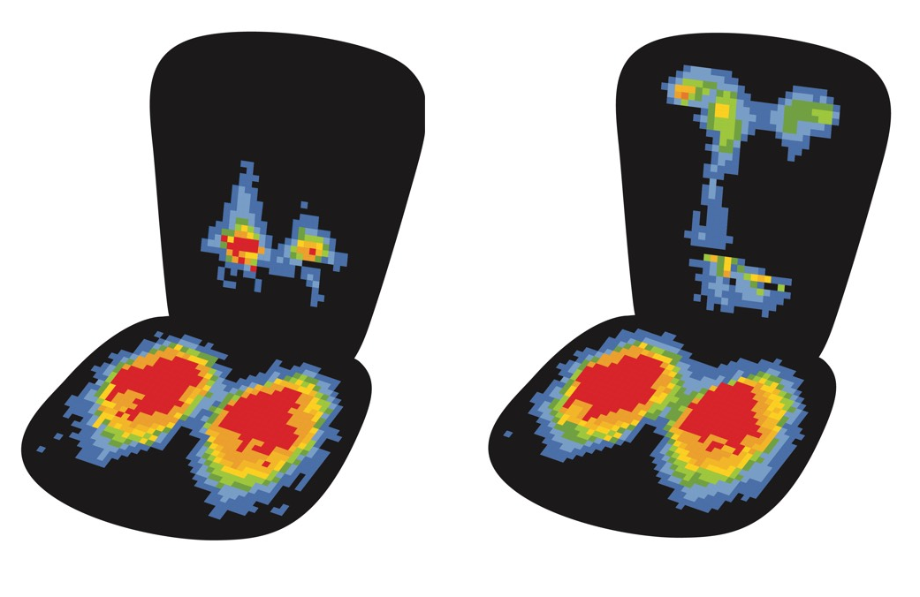
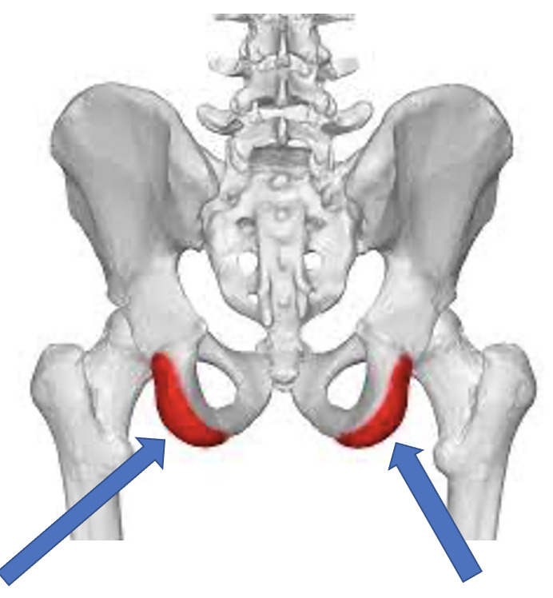
Weight Distribution and Upright Posture
Research reflects trends in upright posture and weight distribution
Peak pressure points located in ischial tuberosities
Pressure peaks remain generally symmetrical laterally across the body
Goal: Implement and position sensors into chair cushion to detect differences in weight distribution associated with trends
Notes:
In preliminary research to assess another quantity best suited for posture sensing in tandem with our IR sensors, we found a trend between user upright posture and weight distribution in a chair. The seat map below demonstrates an instance of ideal upright posture with findings of peak points in weight distribution located at the users ischial tuberosities. This means that these bones are engaged and the majority of the users weight are concentrated at these areas when proper sitting upright posture is demonstrated. Along with this we found that patterns in peak pressure distribution remain symmetrical laterally across the body. With the identification of these trends our goal was to implement and position sensors into the chair cushion to detect differences in weight distribution associated with these trends.

Slide 10
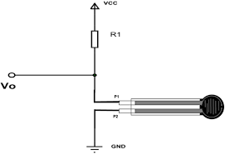
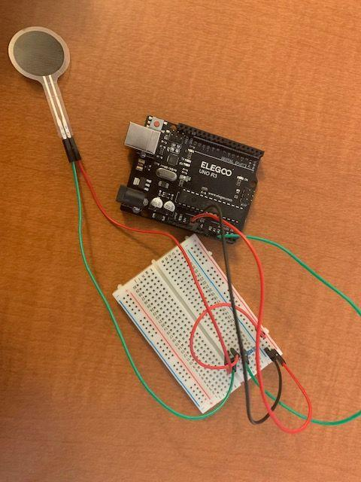
Implementation of FSR and Results
Configured sensor wiring to model voltage divider circuit to read changes in voltage and calculate force
Testing FSR’s on various surfaces and sandwiched between materials
Result: Sensors only able to detect force on hard surfaces
Testing various forces within range capability (60lb), FSR unable accurately measure higher forces
Attempted to increase sensitivity to higher forces by adjusting resistance value in voltage divider circuit
Result: Produced only slightly more accurate readings, sensor still unable to detect weight distribution
Objective failed: inability to detect human weight distribution within our experimental constraints
Notes:
In our first prototype we utilized thin, circular force sensitive resistors for this purpose.
Objective Failed: inability to detect human weight distribution,and function properly when implemented inside our chair cushion
Force sensitive resistor

Slide 11
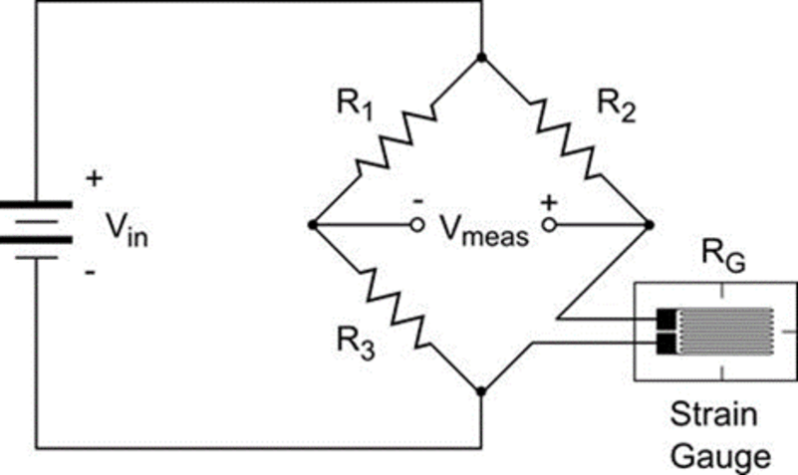
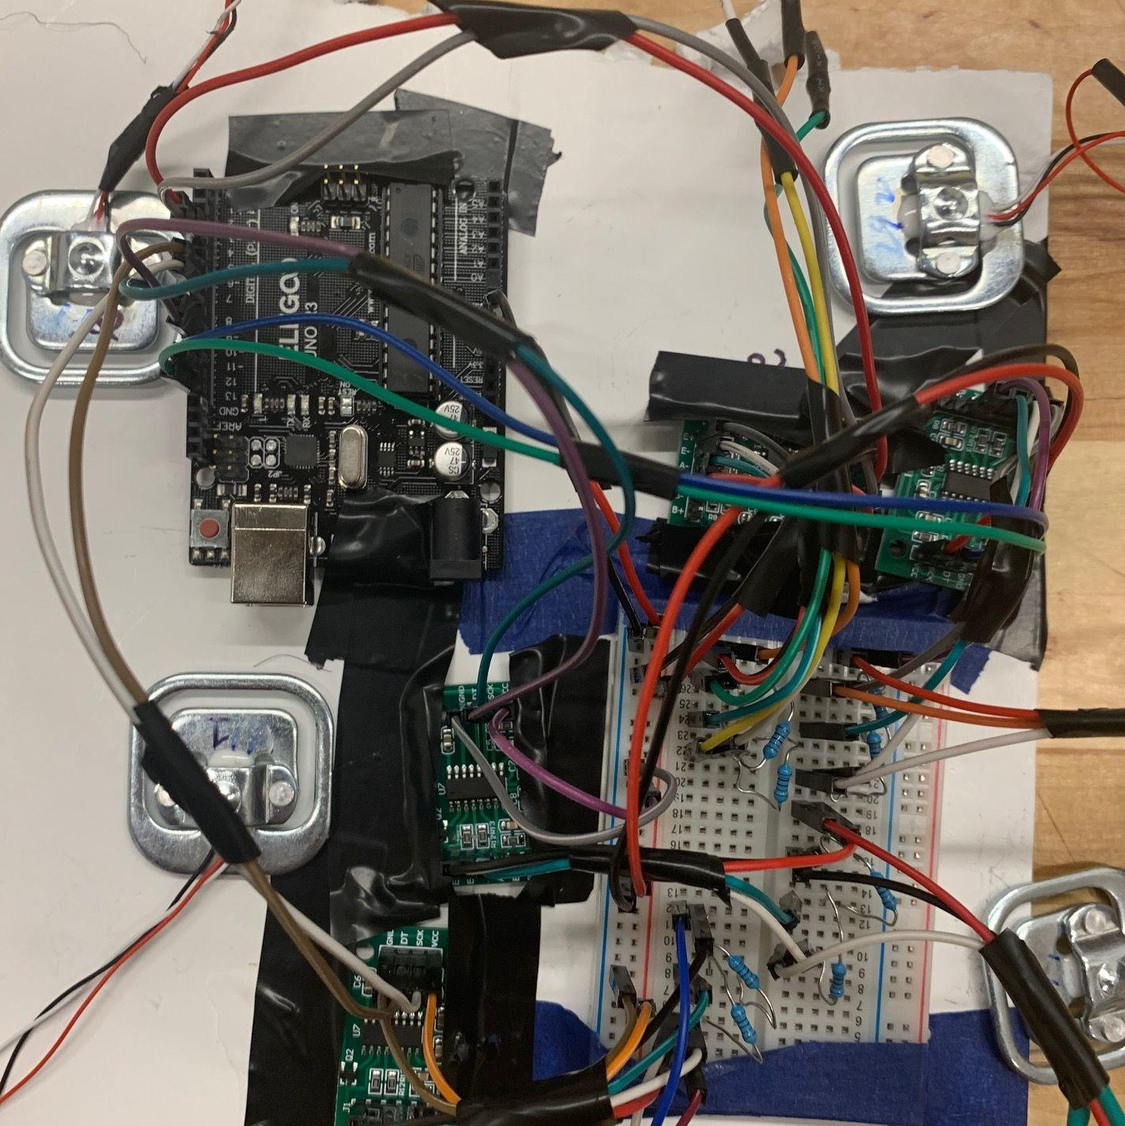
Implementation of Load Cells and Results
Configured sensor wiring to model Wheatstone Bridge Circuit to read changes in resistance and calculate force
Testing cells on various surfaces and sandwiched between materials
Result: Load cells accurately detect forces while sandwiched between foam and leather of our chair
Testing various forces within range capability (50lb)
Result: Load cells able to effectively detect changes in weight distribution
Objective Met: Able to detect changes in human weight distribution within our experimental constraints
Positioned sensors on seat to detect weight changes
Need more user testing to identify tolerance bounds
Notes:
In prototype 2 we implemented load cells into the seat cushion and tested their ability to assess weight distribution.

Slide 12
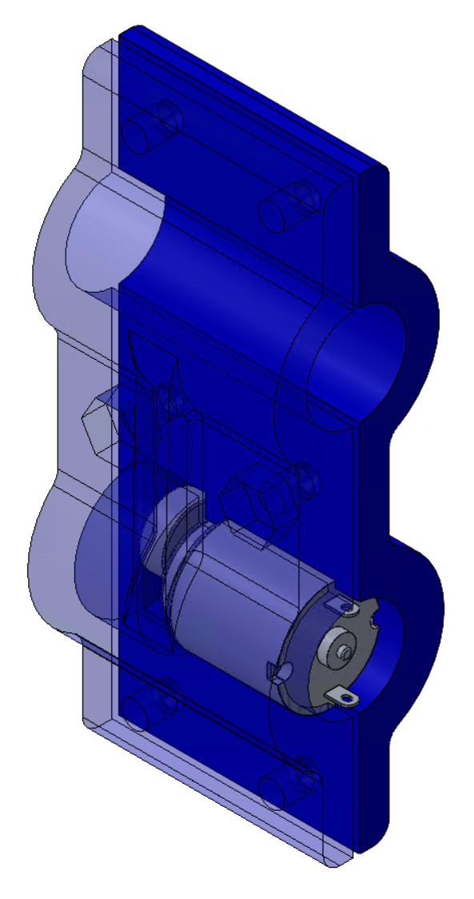
Prototyping: Vibration System Plan
Goal: Proof of concept that we could provide haptic feedback (vibrations) to the user
Plan: Mount motor system to seat bottom with 3D printed mounts to determine:
Whether vibrations could be felt
What changes would have to be made to the mount design
Motor Mount CAD
Notes:
Our goal was to prove that we could provide vibration feedback to the user
We wanted to mount a motor system to the seat bottom to determine
If the vibrations could be felt
And what changes would need to be made to the mount design

Slide 13
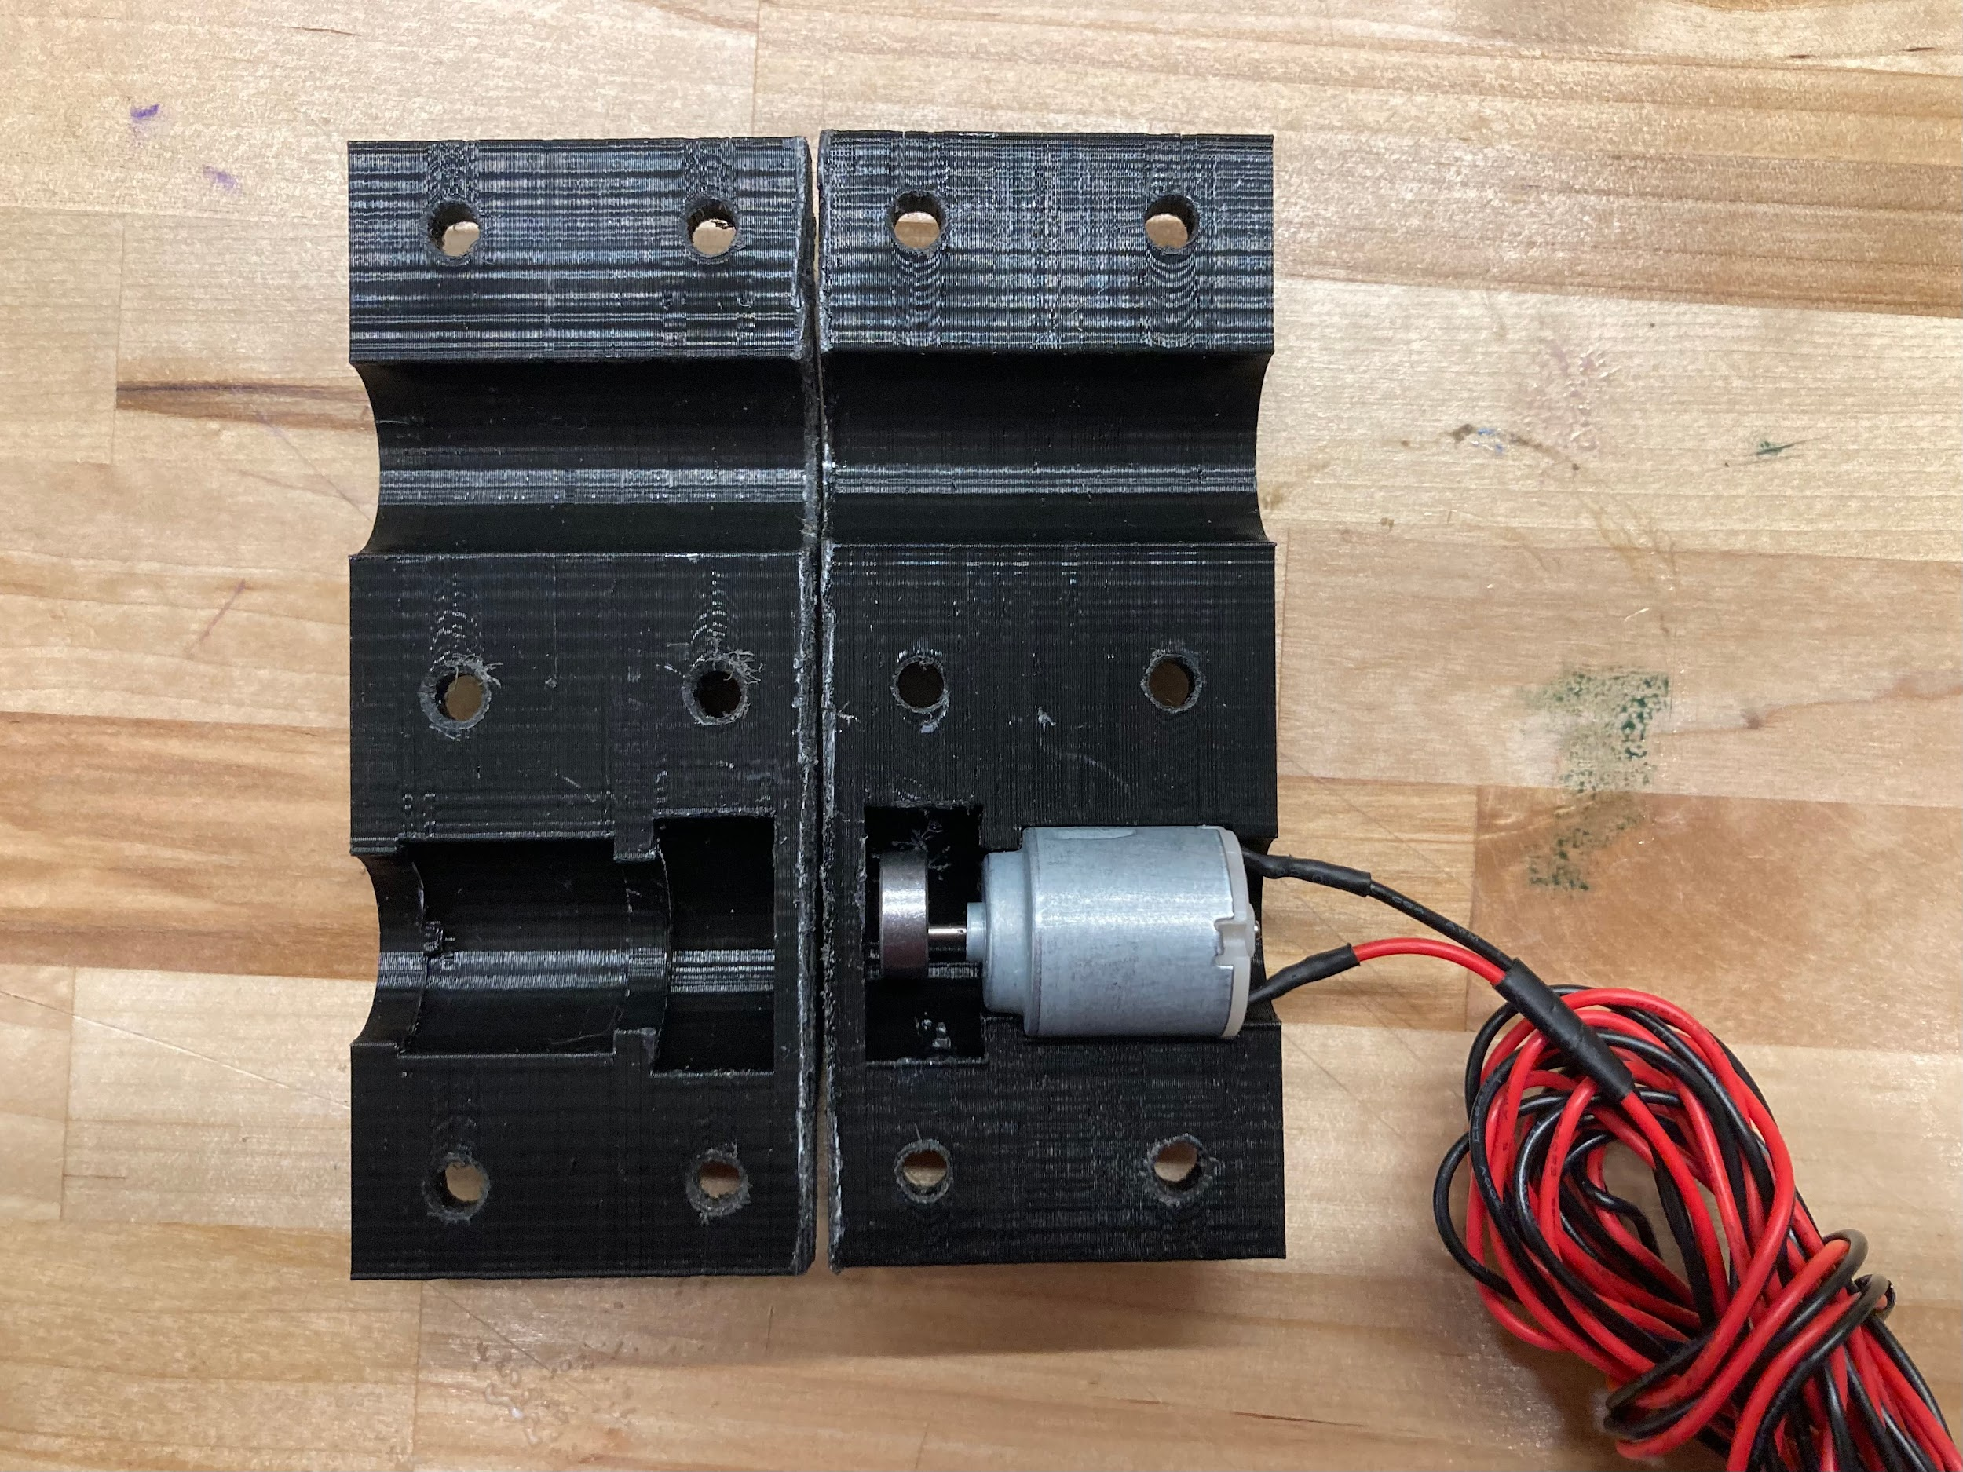
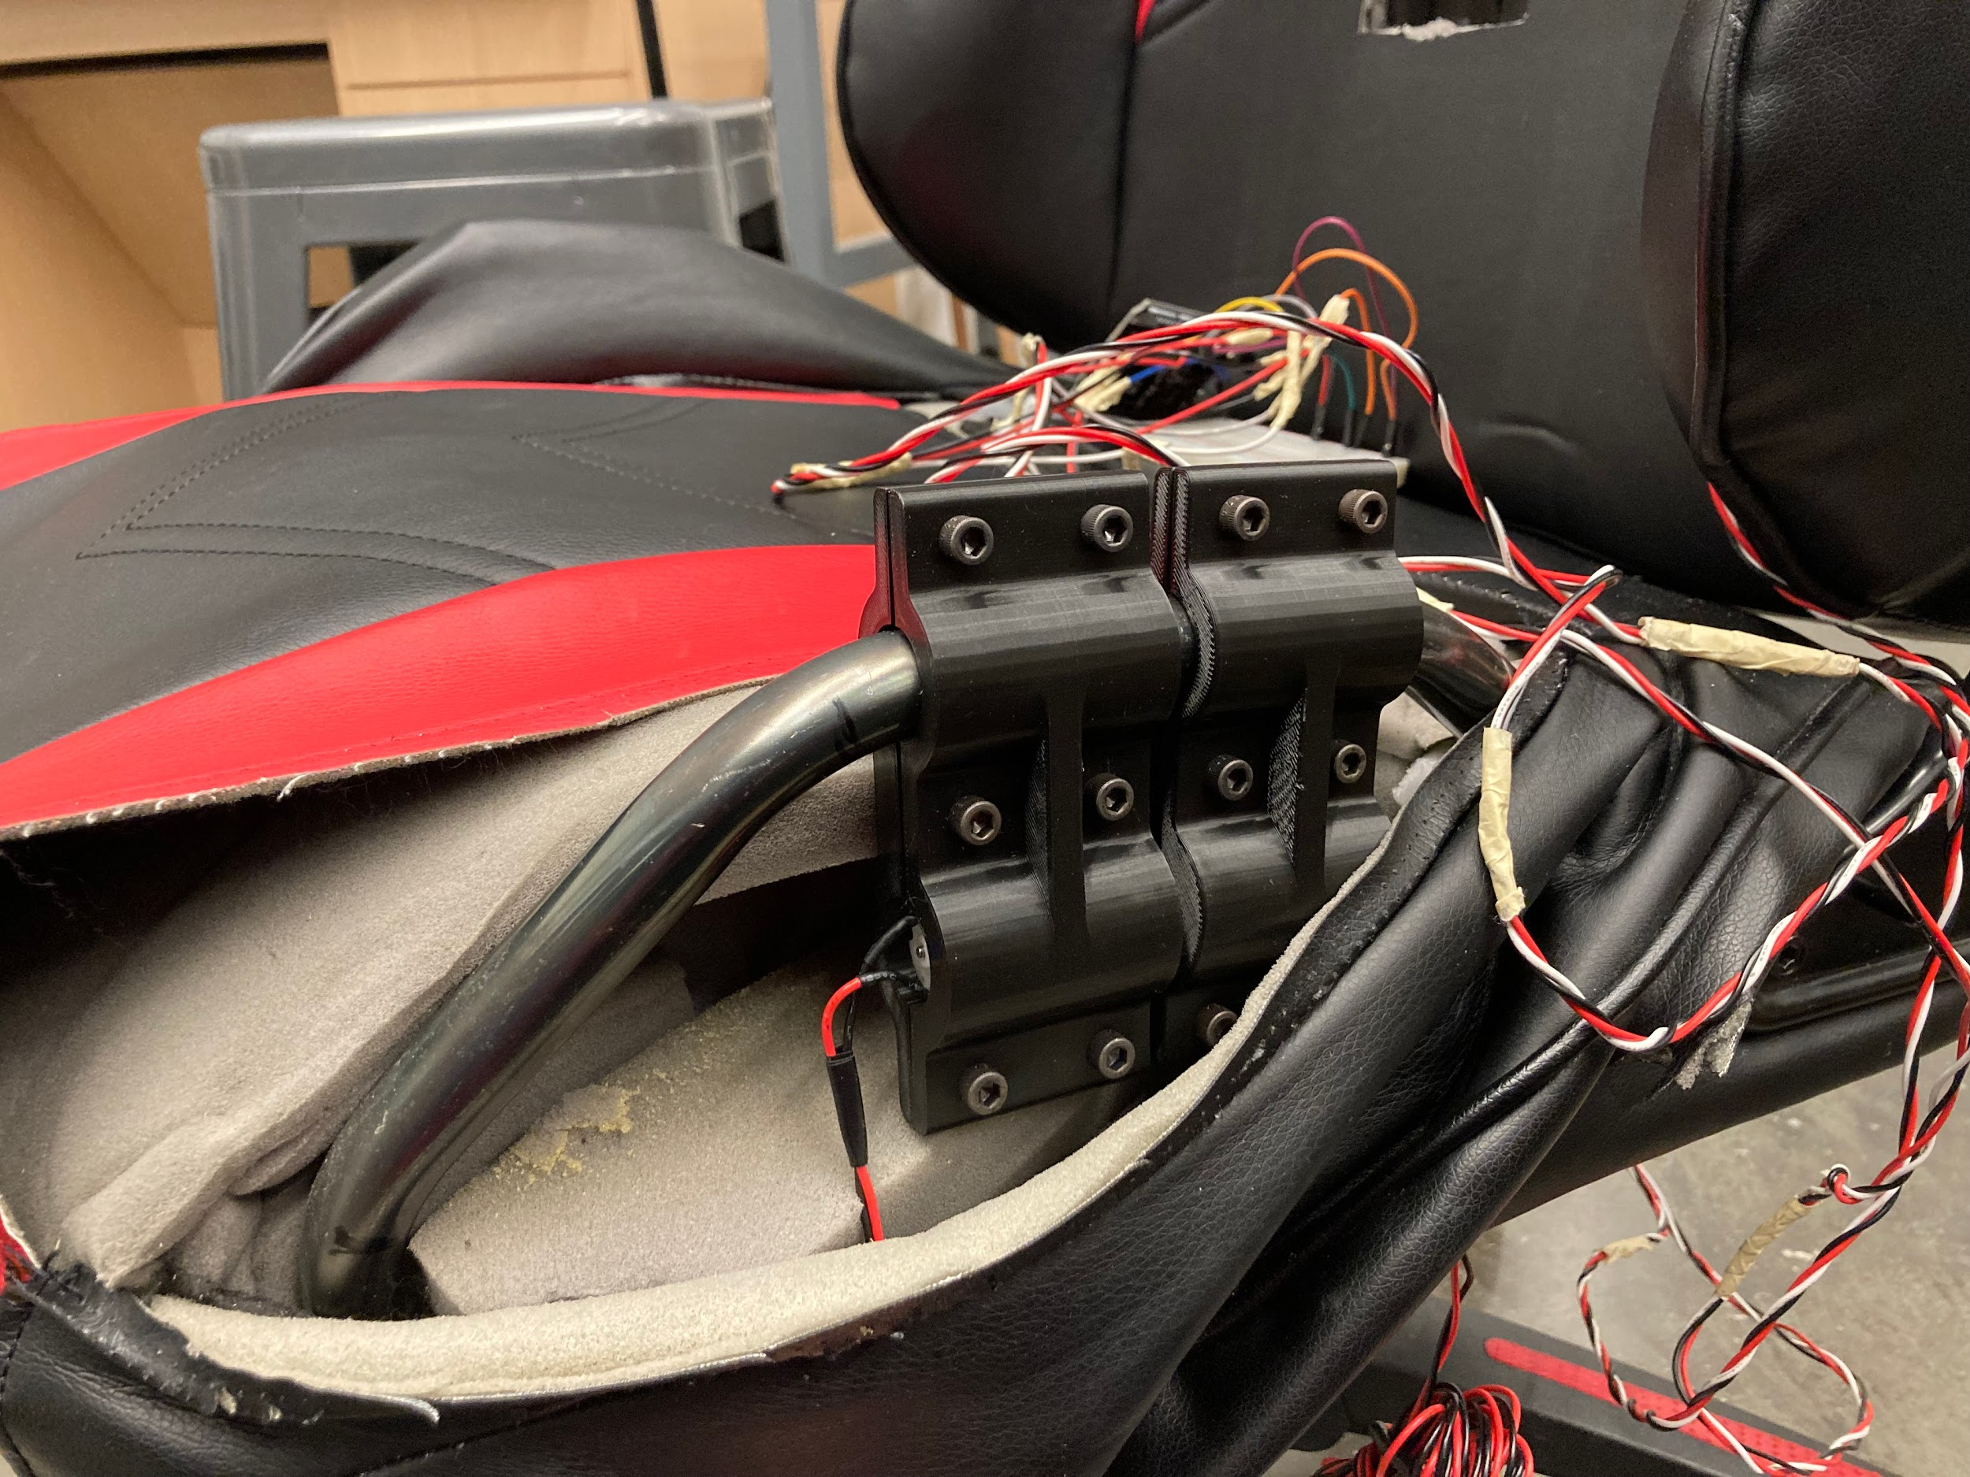
Prototyping: Vibration System Demo
3D Printed Motor Mount
Prototype on Chair
Notes:
We 3d printed the mounts as seen and here is the picture of the system attached to the seat of the chair

Slide 14
Prototyping: Vibration System Results
User Feedback
Target correction area unclear
Further customization options
“Felt like a massage chair”
Conclusions
Mount needs to change to make it easier to assemble
Vibration could be felt with just 2 motors
Concept works
Notes:
Overall, user feedback was that the
Area that needed to be corrected was unclear
They would like to further customize the feedback, such as changing the vibration level
They liked the vibrations
To quote, it felt like a massage chair
Overall
We found that the mount needs to change as it was difficult to assemble
However the vibrations could be felt with just two motors!
Therefore the concept works!

Slide 15
Prototype, Testing, and Research Plans
Combined User Interface & Subsystems
Set baseline
See IR sensor data
See weight distribution data
Data smoothing
Vibrations integration
Minimum weight to prevent extraneous data
User testing with full system
Follow up with physical therapist on our current prototype

Slide 16
Challenges and Solutions
Getting all sensors working on one arduino
Clean wiring and code
Data smoothing and interpretation
Testing new algorithms and filters
Creating easy to use and intuitive UI
User testing and feedback on work in progress UI
Interference from clothing
More reliance on weight distribution data

Slide 17
Timeline
Objective | Due Date
All sensors permanently integrated into chair | 11/21
Arduino functionality combined and stored in electronics box | 11/28
User testing with fully integrated chair | 11/30
Wireless connectivity and UI created | 12/5
Finalized UI and user initiation sequence | 12/12

